Slide 1
Deep Predictive Learning A Comprehensive Model of Three Visual Pathways
Randall C. O’Reilly
University of Colorado Boulder
eCortex, Inc

Slide 2
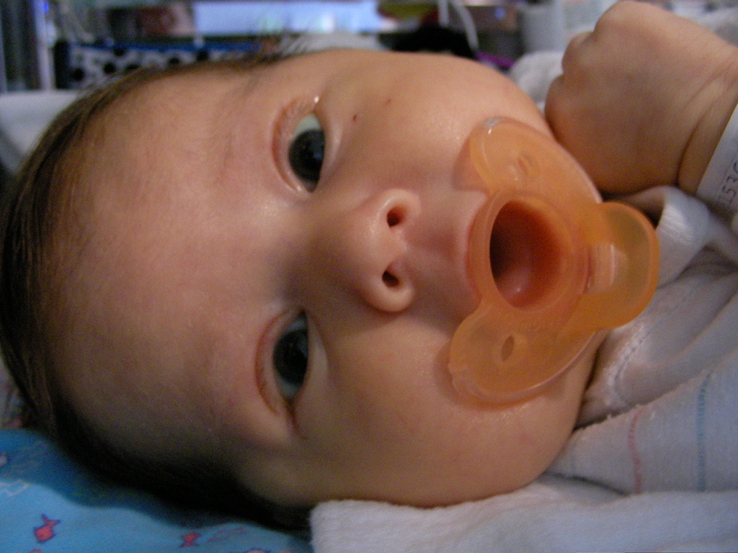
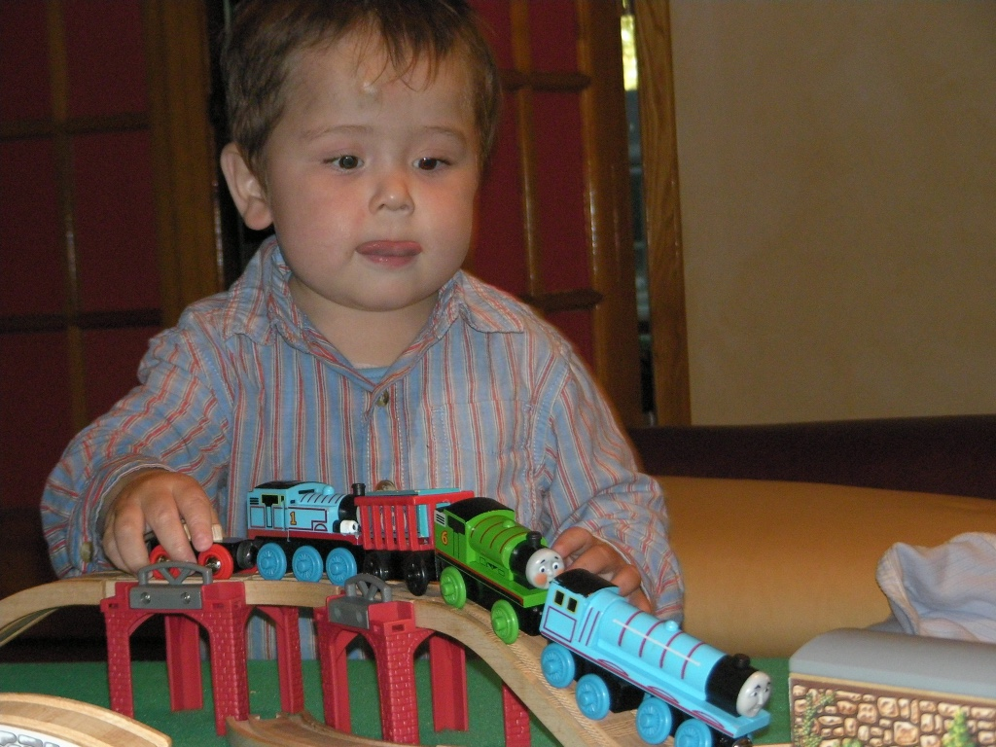
The Mystery of (Knowledge) Development
The first ~6 months: passive, but intent, staring at the world moving by..
And yet, so much is learned: the foundation for everything we know..
How does this happen!?

Slide 3
Invariant Object Recognition is Hard
Different objects in same location share many features
Same object in different locations shares NO features
Hebbian: “fire together = wire together” – exact opposite!

Slide 4
Deep Convolutional Neural Nets
Solve the invariant recognition problem; high performance,
but dependent on huge datasets of hand-labeled images
Baby does not have access to these labels!
(and monkey certainly doesn’t!)

Slide 5
Predictive Models: use model inferred on prior sensory input to predict next sensory input vs.
Generative Models: typically iteratively infer model from current sensory input, and then “predict” that same sensory input.

Slide 6
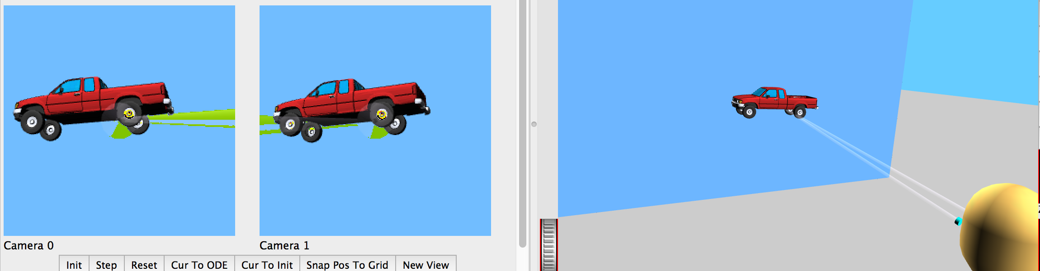
Predictive Vision
If you can predict it, you know it!
Desirable difficulty of predictive learning.
The future is free!
No need for hand labeled data.

Slide 7
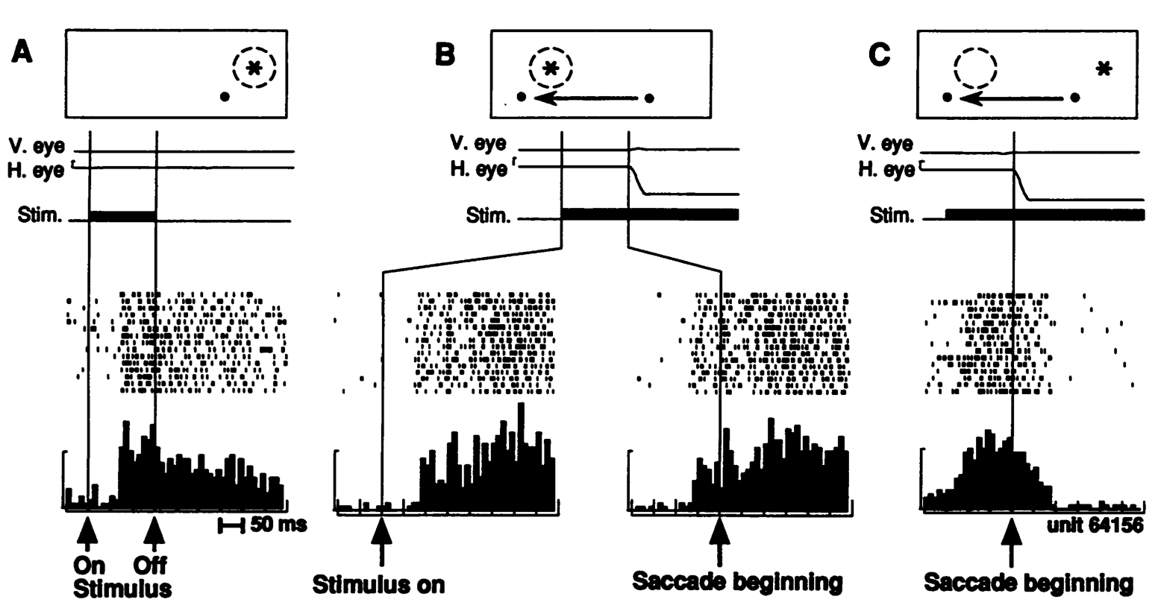
Predictive Remapping Duhamel, Colby & Goldberg (1992)
LIP neurons anticipate effect of saccade, start firing for new location before fixation lands (even before saccade starts!)

Slide 8
Central Hypotheses
Error-driven learning from diff between prediction and what happens next
Prediction – outcome cycle = 100ms = 10hz = alpha
Cortical deep layers drive prediction on Pulvinar
Layer 6CT neurons drive prediction
5IB (alpha burst) from lower layers drive outcome
Error is temporal diff, broadcast fm pulvinar
Local temporal-diff learning throughout cortex

Slide 9
The Pulvinar = Projection Screen (c.f. Mumford, 1991 “blackboard”)
Pulvinar receives connections from all over visual cortex
and projects back out to these same areas
Two qualitative inputs:
1. Few strong driving inputs – feedforward
2. Many weaker feedback “modulatory” connections
Pulvinar!

Slide 10
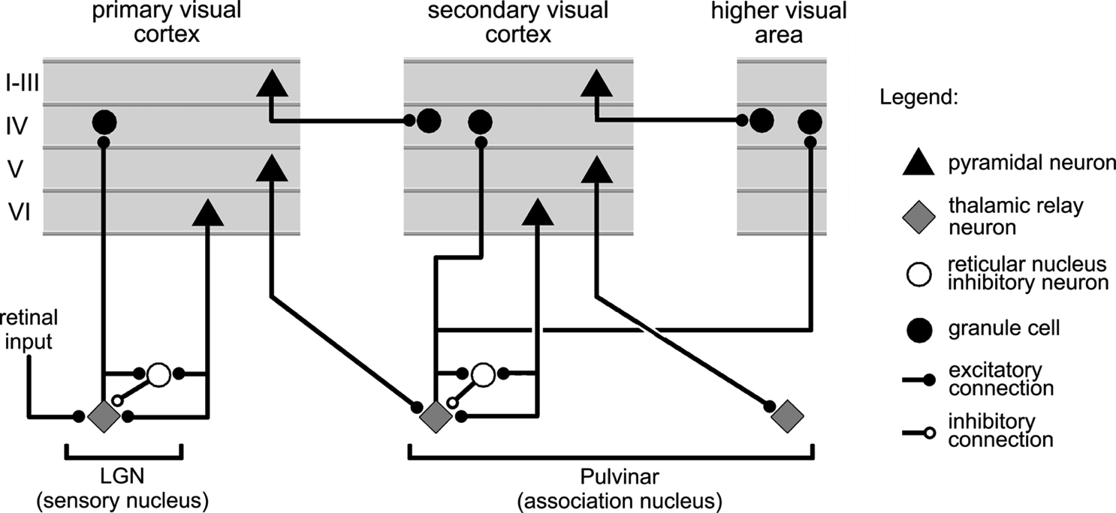
Thalamocortical Loop Biology (Sherman & Guillery, 2006)
5IB
FF
Driver
Weak
FB
What is function of strong feedforward driver vs. weaker feedback pathway?

Slide 11
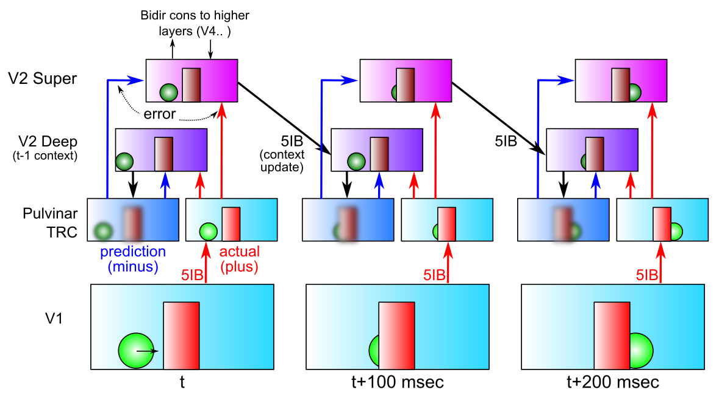
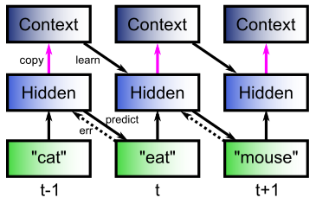
DeepLeabra Predictive Learning
- Deep neocortical layers generate prediction using prior context (SRN)
- Activate Pulvinar with prediction in minus phase (first 75 msec)
- V1 5IB (intrinsic bursting, at alpha) drives plus phase (last 25 msec)
- Error-driven learning on temporal difference improves prediction

Slide 12
DeepLeabra Problems and Solns
- Always represent / process the current input: superficial layers
- Yet force system to make a true prediction (“about the future”):
deep layers, cutoff from current input, rely on prior context
- Error signal available to everyone, everywhere: temporal difference
much simpler than explicit error-coding; integrates all forms of error

Slide 13
To Make IT Work:
1. Compact high-level representations (What, Where) needed for effective prediction at lowest levels:
Short-cut top-down projections
Earliest possible learning of abstractions
2. Shared “projection screen” where different visual pathways collaborate to create full prediction
Allows full prediction to be solved with separate, specialized pathways
3. Partition prediction error progressively, opportun-istically, to develop separable abstract pathways
Easy to develop abstract Where pathway – do this first!
Residual then concentrates What information
Also need What*Where binding pathway: V3, MT, DP?

Slide 14
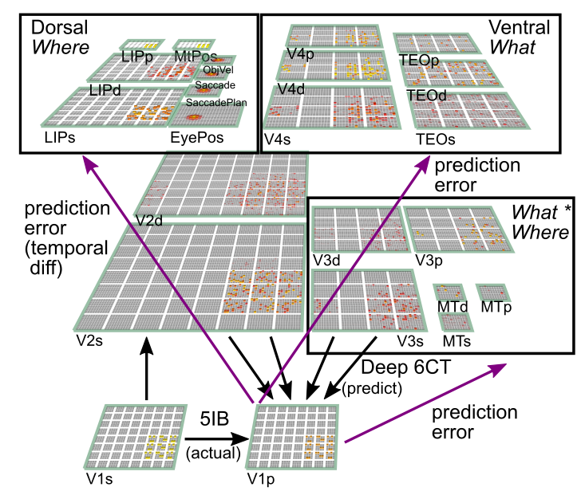
What-Where-Integration Model (O’Reilly, Wyatte & Rohrlich, submitted)
3 Separable pathways
Where develops first using location blobs
What*Where needed for binding two streams
What takes longest, requires other errors to be factored out first
Pulvinar is shared projection screen for predictions
Predicts next visual input at 100 msec (10hz, alpha) frequency
Pulvinar

Slide 15
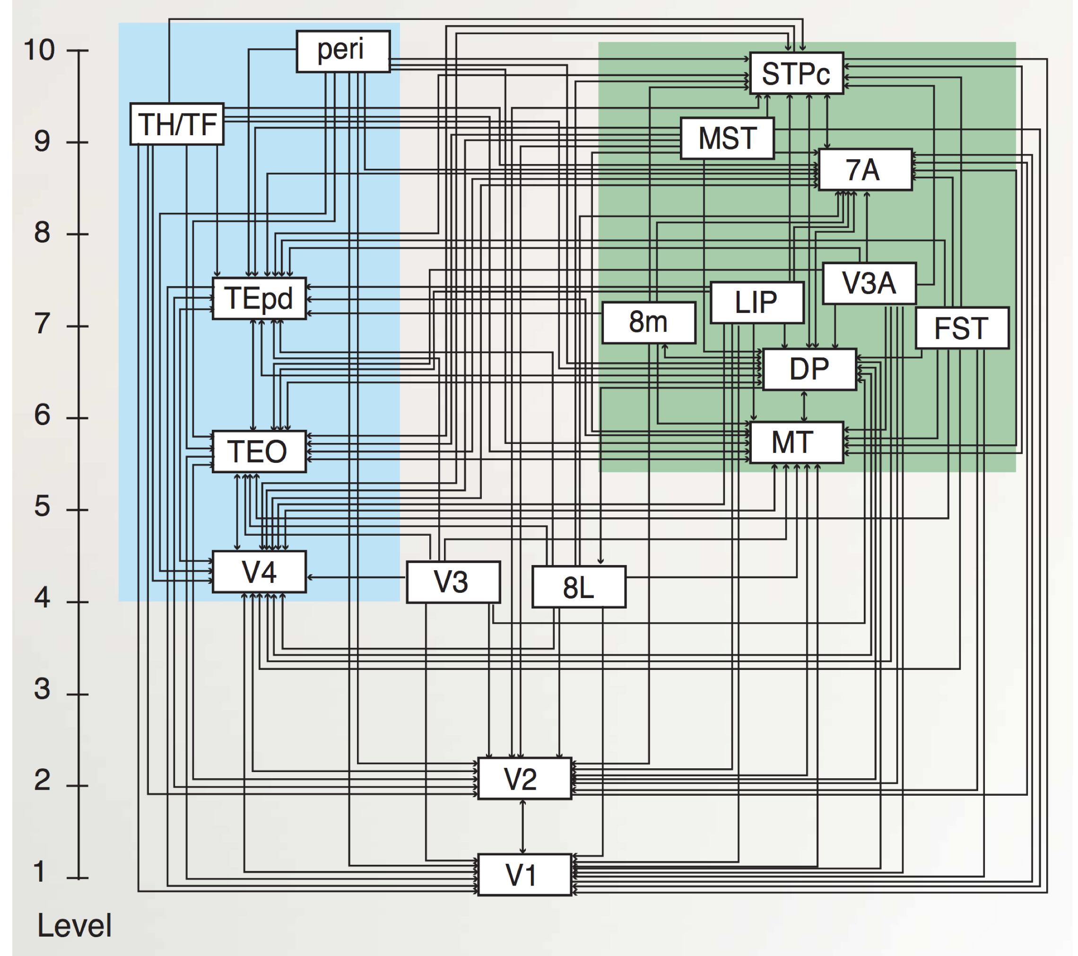
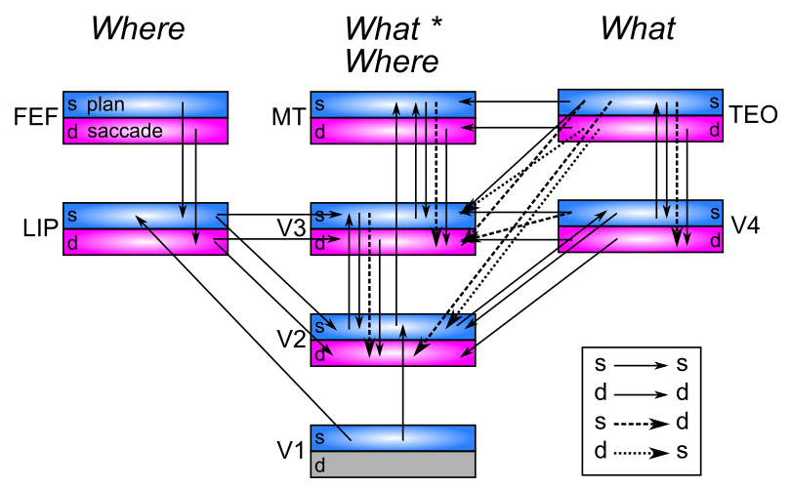
Pathway Interconnectivity
Markov et al, 2014
Extensive interconnectivity between areas – really pathways??
(Freud, Plaut, & Behrmann, 2016; de Haan & Cowey, 2011; Schenk & McIntosh, 2010..)
Dorsal has three pathways (Rizzolatti & Matelli, 2003; Kravitz et al., 2011; Haak & Beckmann, 2017)? MT particularly ambiguous (Milner & Goodale, 2006)

Slide 16
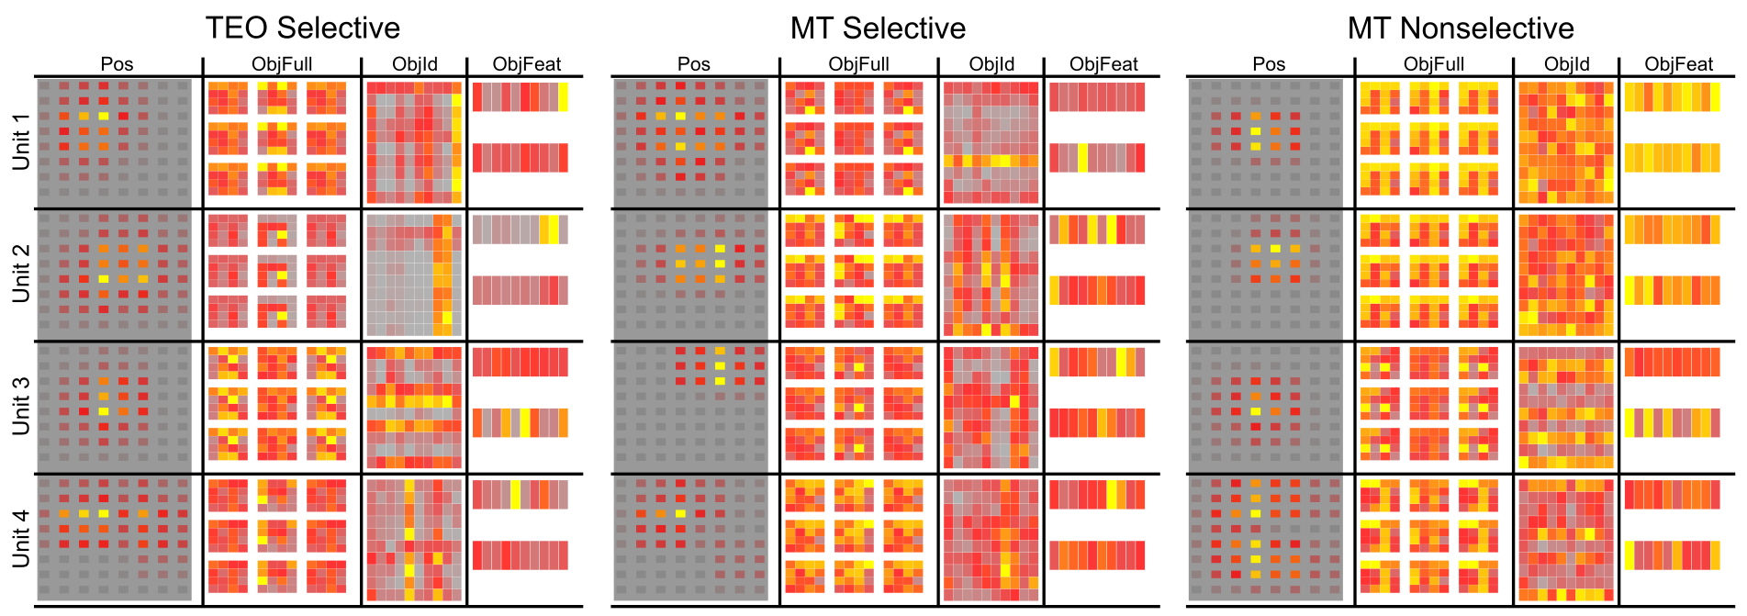
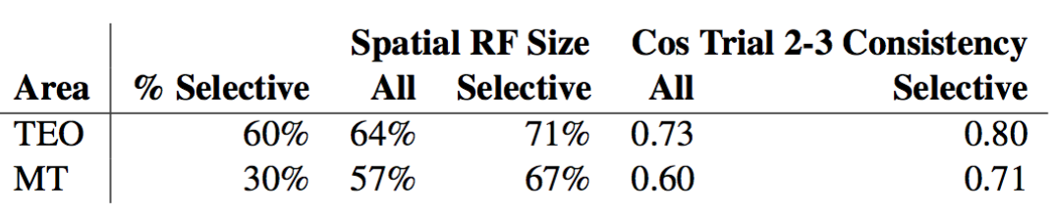
Invariant Object Representations
- 60% of TEO units systematically selective for specific features
over broad spatial Pos tuning: invariant object reps!
- 70% of MT nonselective, binding What*Where

Slide 17
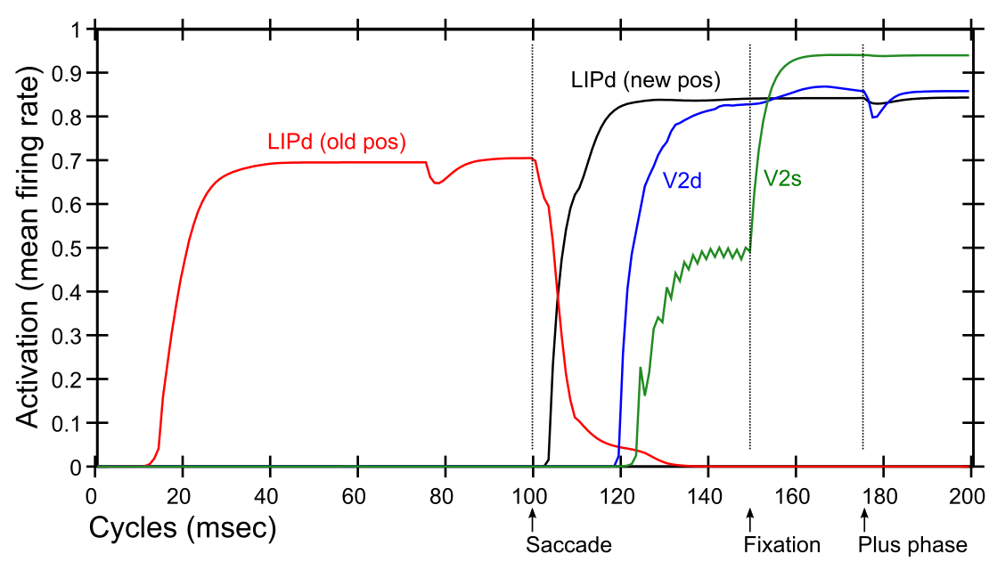
Predictive Remapping
Duhamel et al. (1992):
LIP neurons anticipate effect of saccade, start firing for new location before fixation lands (even before saccade)
Model:
LIPd remaps first at high, abstract level, drives top-down remapping in lower areas – consistent with Cavanagh et al. (2010)

Slide 18
Central Hypotheses
Error-driven learning from diff between prediction and what happens next
Prediction – outcome cycle = 100ms = 10hz = alpha
Cortical deep layers drive prediction on Pulvinar
Layer 6CT neurons drive prediction
5IB (alpha burst) from lower layers drive outcome
Error is temporal diff, broadcast fm pulvinar
Local temporal-diff learning throughout cortex

Slide 19
Thanks To
CCN Lab
Will Chapman
Tom Hazy
Seth Herd
Kai Krueger
Jessica Mollick
Ananta Nair
John Rohrlich
Jake Russin
Dean Wyatte
Maryam Zolfaghar
Collaborators
Tim Curran
Hellene Devillez
David Sheinberg
Shaobo Guan
Funding
ONR – Hawkins
ONR – McKenna & Bello
IARPA – ICArUS
NIMH P50-MH079485

Slide 20
Extras

Slide 21
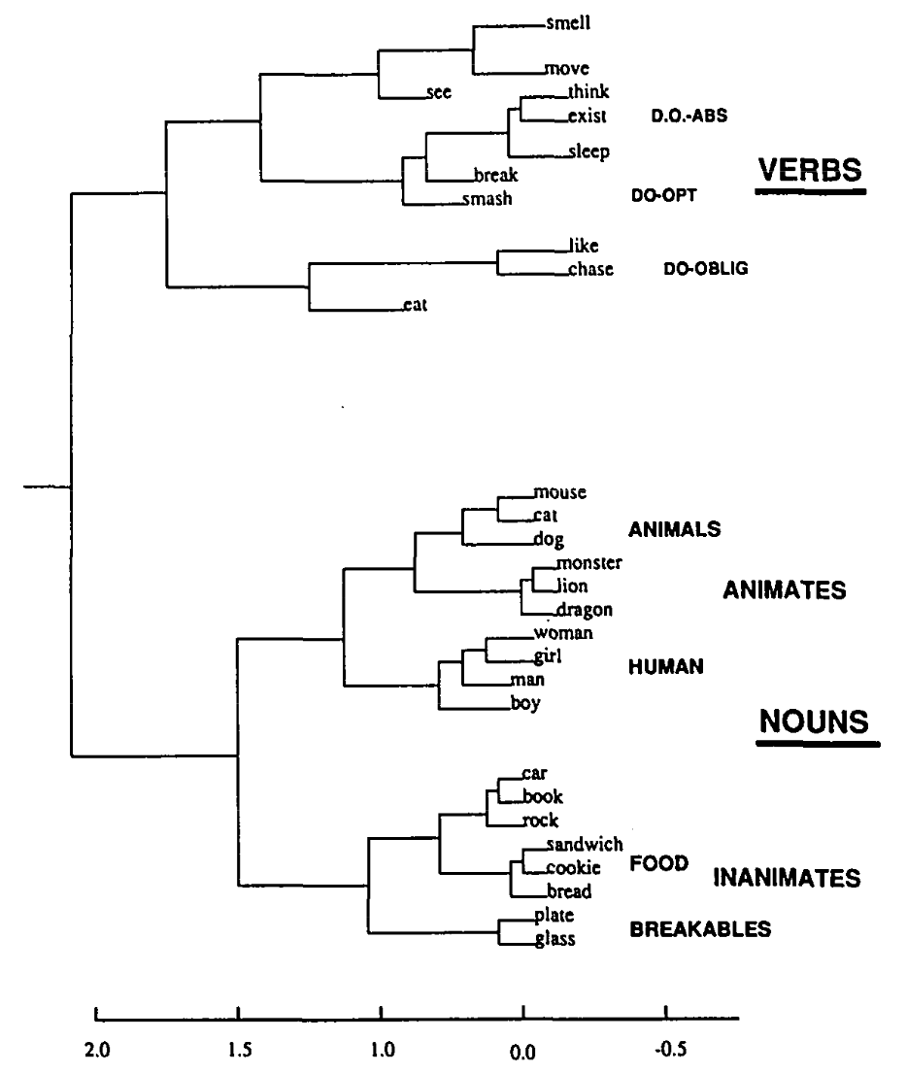
The Predictive Bootstrap (Elman 1990; Elman, Bates, et al. 1996)
Learning to predict words induces verb vs noun category representations in hidden layer of SRN
The future is free!
If you can predict it, you know it!

Slide 22
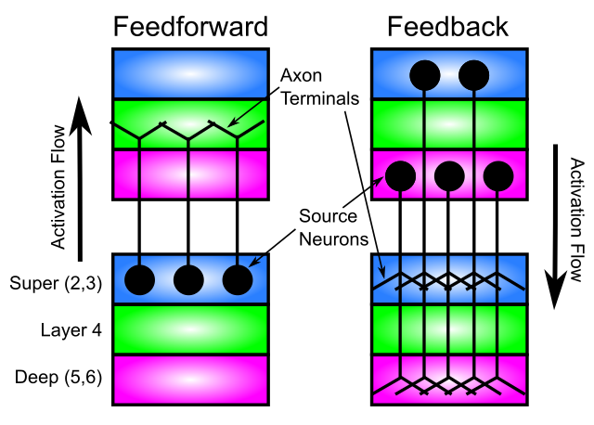
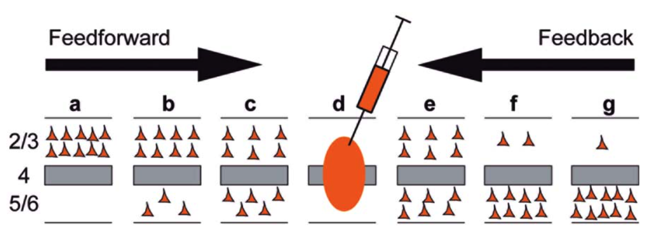
Key Connectivity Constraints
- Critical that feedforward does not project directly to deep layers:
This would short-circuit prediction process
(needs ”eyes closed” to predict)
- Deep feedforward not useful in our model, and rare in brain
- Deep feedback essential – dominates at longer distances

Slide 23
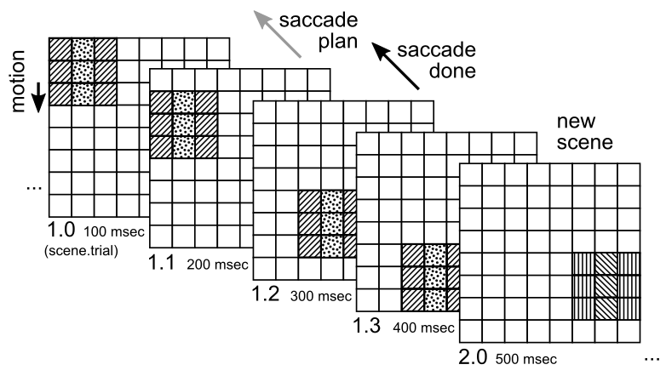
Goin’ to the movies!
- Prediction requires coherent movies over time (not just random images)
- Simple environment with stable object features and both object motion
and saccadic motion
- Minimal case for maximum simplicity and predictive accuracy:
makes bugs, and gradients for model improvement, more obvious

Slide 24
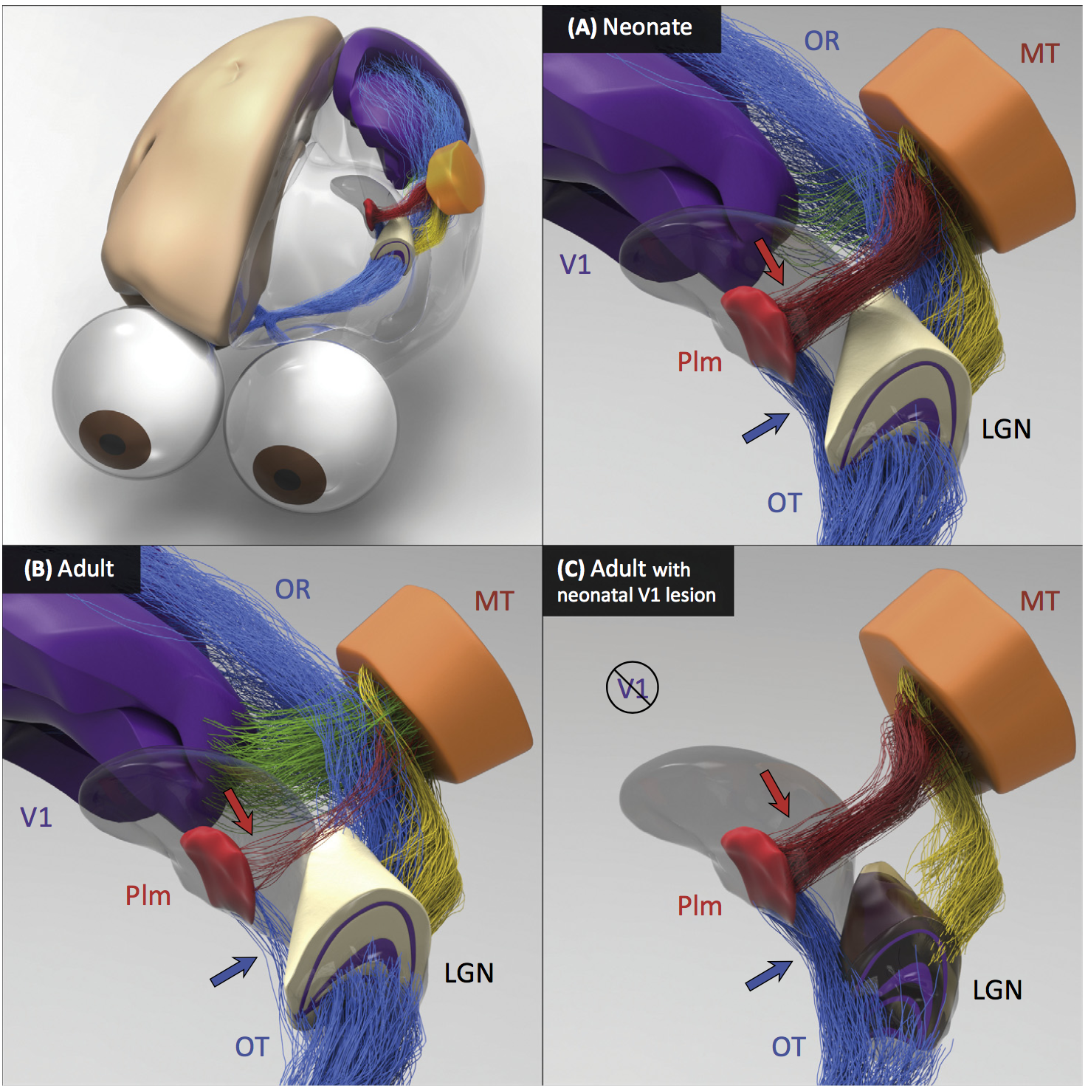
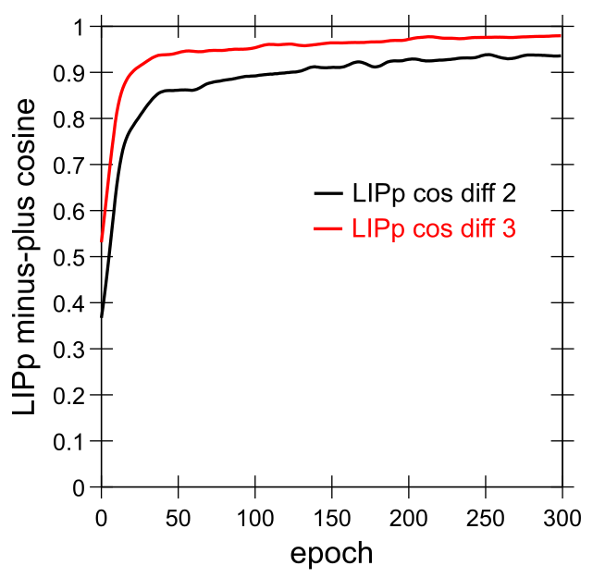
Early What Development
Bridge, Leopold, & Bourne, 2016:
Neonate: direct shortcut from LGN to Pim = Pulvinar which then trains MT and Where pathway
Adult: loses retinal shortcut, has more cortical (V1, etc) drive.
Model: quickly learns Where pathway into LIP, predicting object motion and saccades:

Slide 25
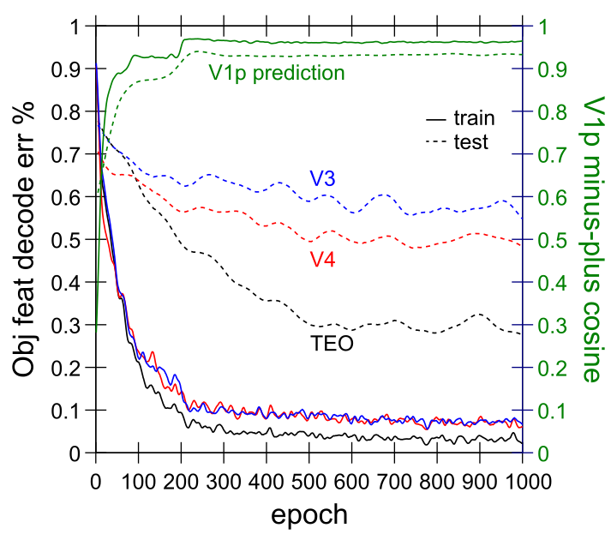
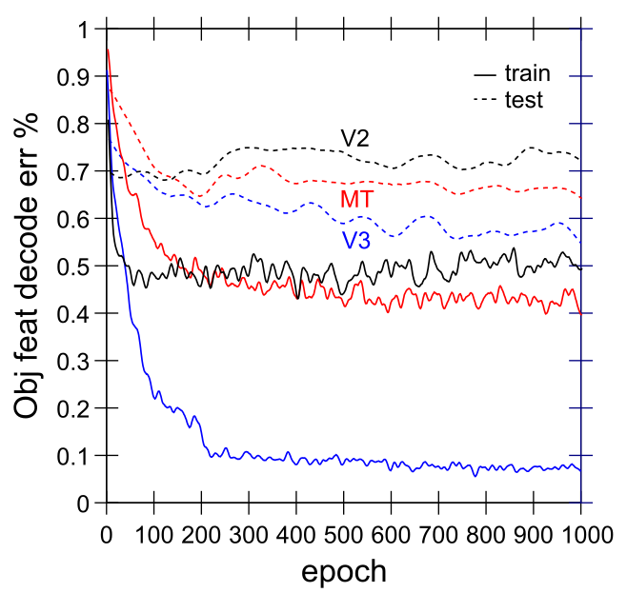
Full Model Training Results
- High accuracy V1p prediction: cosine near 1 (1=perfect)
- High accuracy decoding of object features in TEO for
trained objects, significant generalization to test objects
- Progression: V2 < V3 < V4 < TEO – but MT much worse
than V3 – specialized for What*Where integration, not What

Slide 26
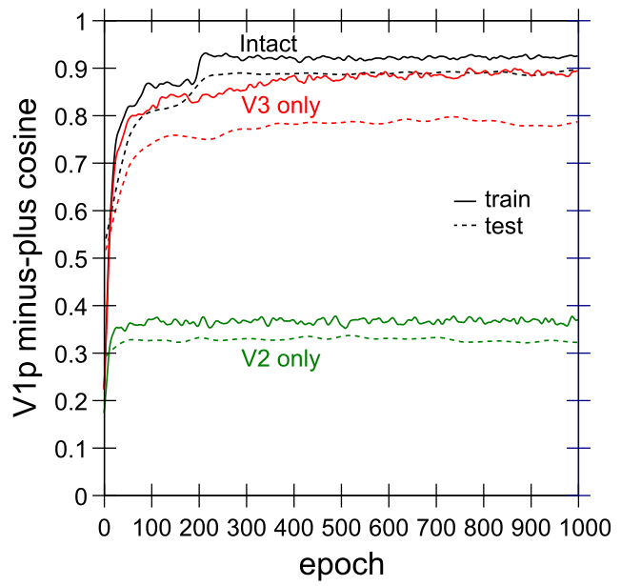
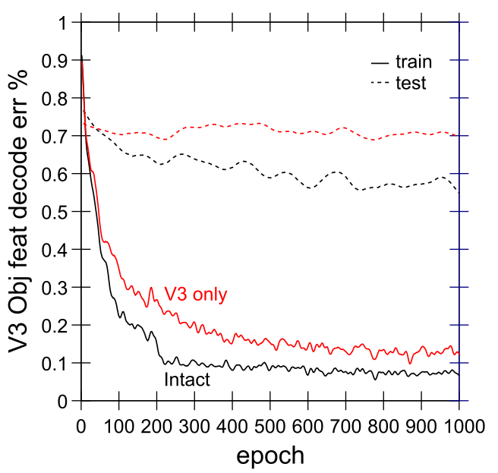
Top-down TEO Important
- V3 can manage pretty well in this simple environment vs V2
- But prediction, object decoding sig better with
TEO top-down to V2, V3 (Intact)

Slide 27
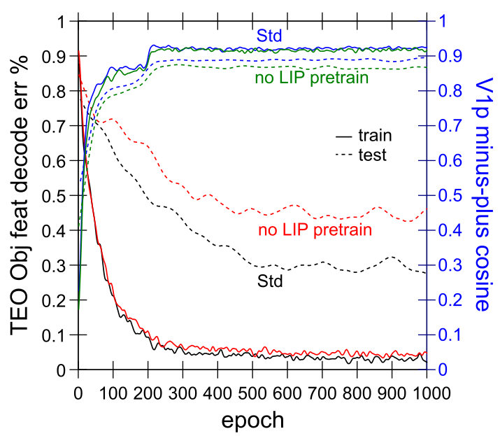
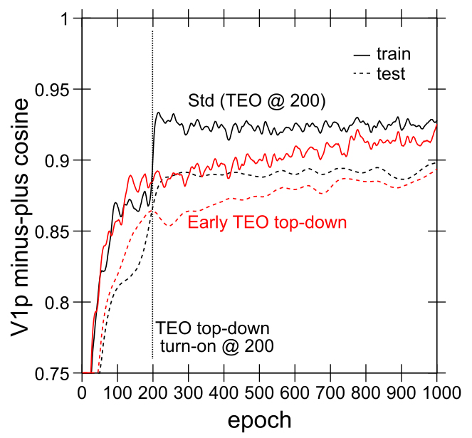
Development Important
- LIP (Where) pretraining improves systematic decoding in TEO
- Delayed TEO (What) top-down weights = better

Slide 28
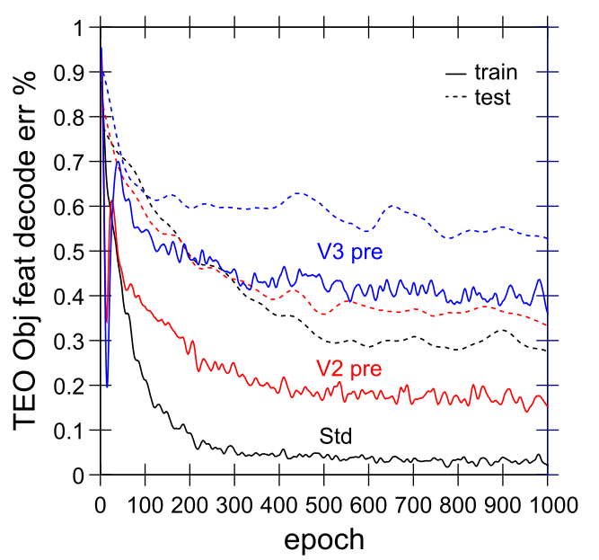
Progressive Bottom-up Not Good
- V2/3 pre = start with weights trained with V2/3 only
- Higher pretraining = worse performance!
- Need abstract, high-level areas shaping learning from the start

Slide 29
Summary: Three Key Principles
1. Compact high-level representations (What, Where) needed for effective prediction at lowest levels:
Short-cut top-down projections
Earliest possible learning of abstractions
2. Shared “projection screen” where different visual pathways collaborate to create full prediction
Allows full prediction to be solved with separate, specialized pathways
3. Partition prediction error progressively, opportun-istically, to develop separable abstract pathways
Easy to develop abstract Where pathway – do this first!
Residual then concentrates What information
Also need What*Where binding pathway: V3, MT, DP?

Slide 30
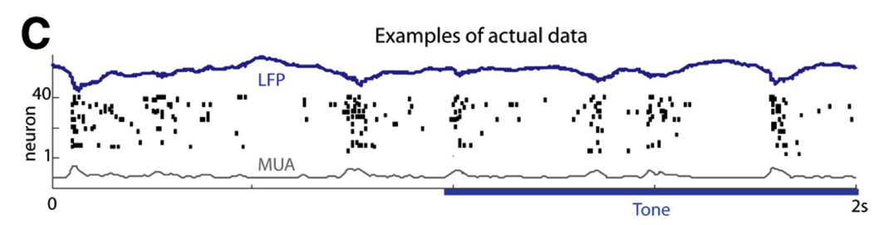
Key Biological Data
Strong, synchronized, low-frequency modulation of cortex (at the alpha frequency).
Specificity of alpha modulation to deep layers & thalamus, not superficial layers.
Nature of deep-layer connectivity to pulvinar: numerous, weaker, plastic pathway (for generating a prediction) and sparse, strong, fixed pathway (for ground truth target).
Synchronization of this strong pathway input with the alpha cycle.
Broad connectivity of pulvinar with different visual pathways (afferent and efferent).
Lack of direct bottom-up superficial projections into the deep layers (would short-circuit prediction), but presence of these projections top-down (beneficial).
Bidirectional (top-down and bottom-up) connectivity between superficial layers.
Early development of the Where (MT, LIP) pathway.
Organization into three separable (yet highly interconnected) visual pathways, particularly a third putative What*Where integration pathway.
(Buffalo et al., 2011; van Kerkoerle et al., 2014; Shipp, 2003; VanRullen & Koch, 2003; Luczak et al., 2013..)

Slide 31
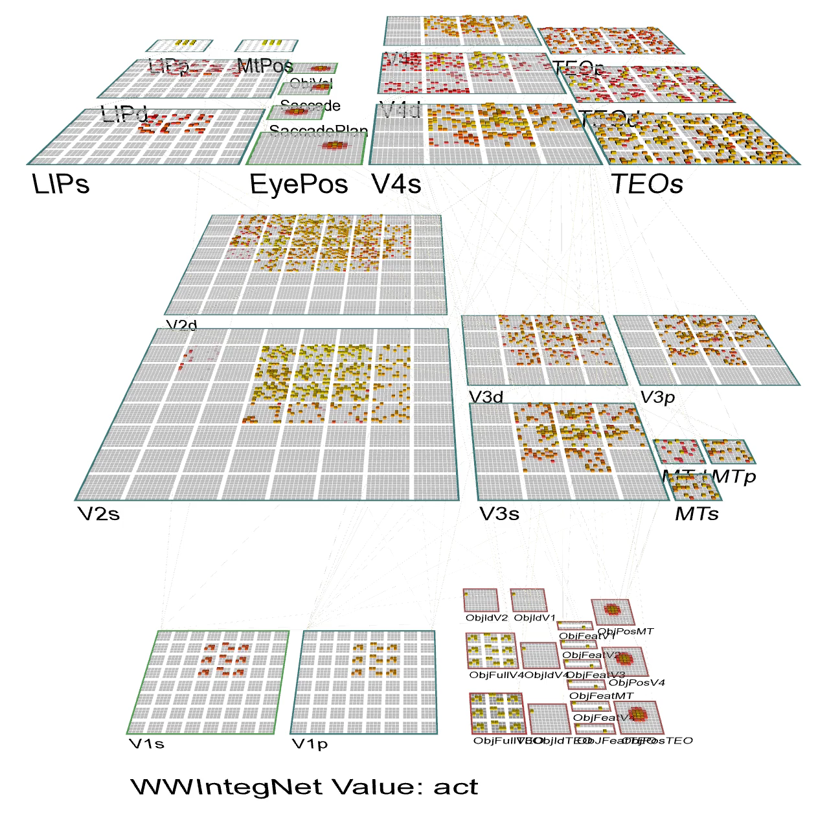

Slide 32
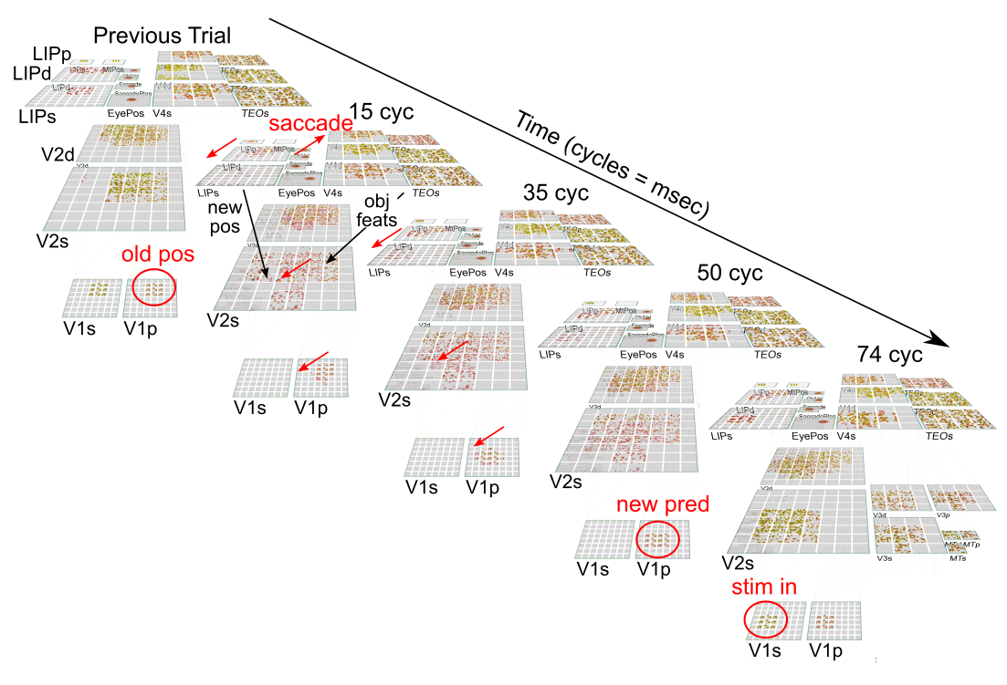

Slide 33
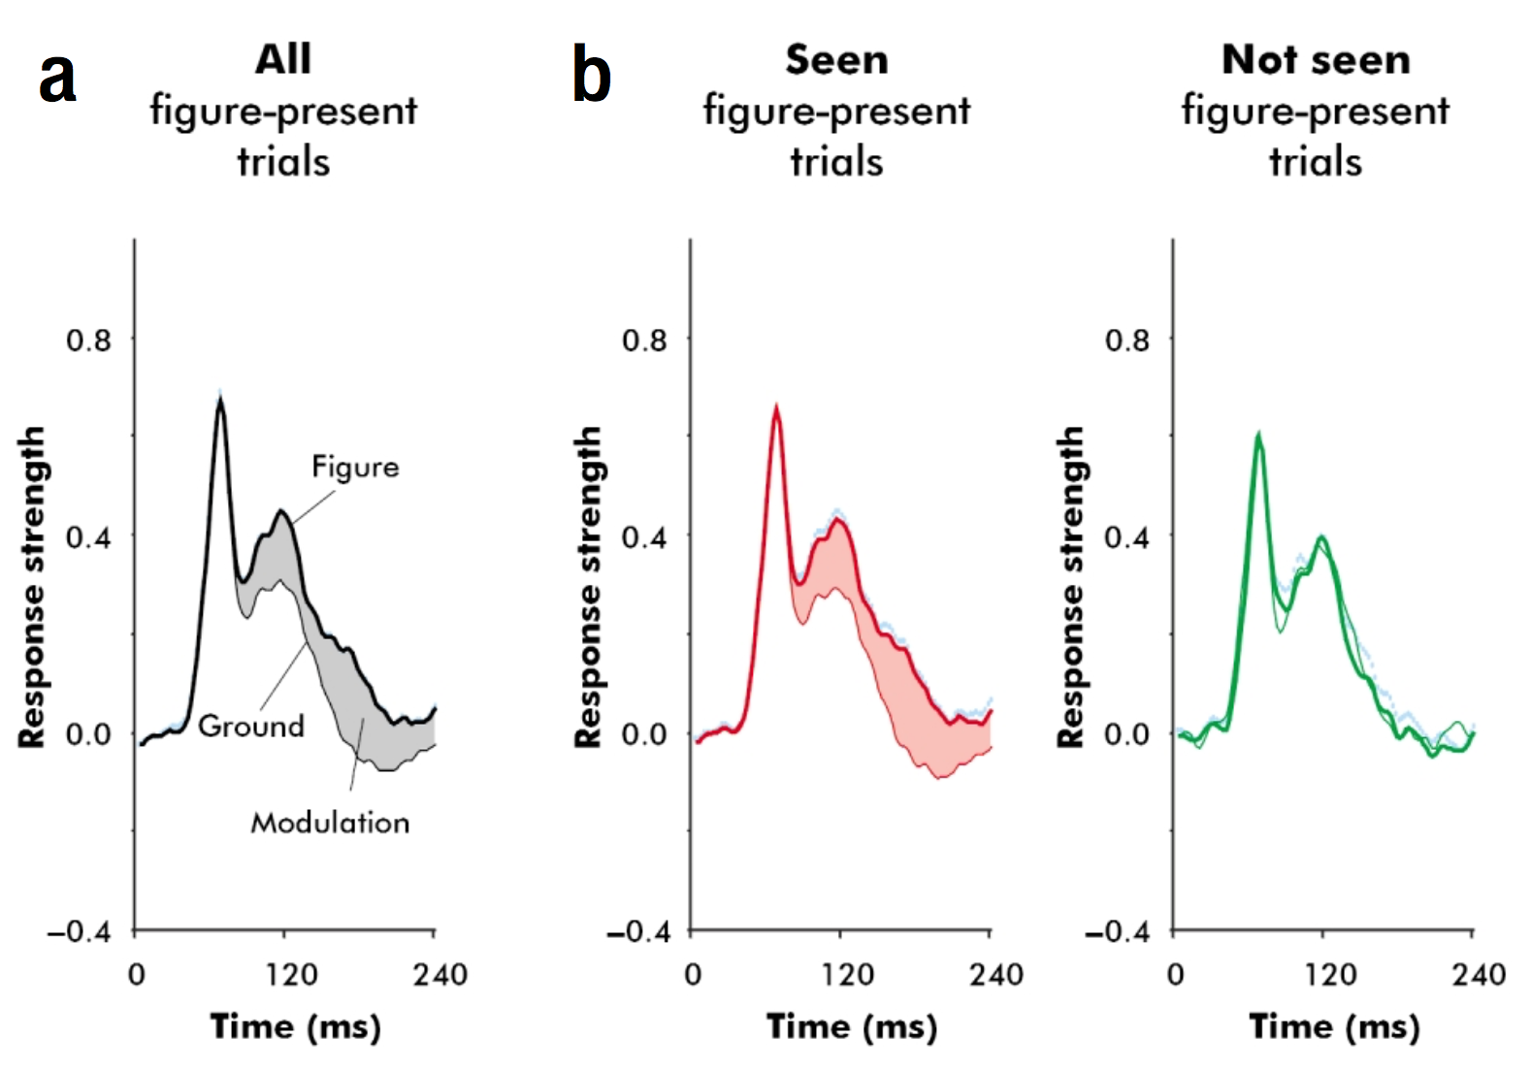
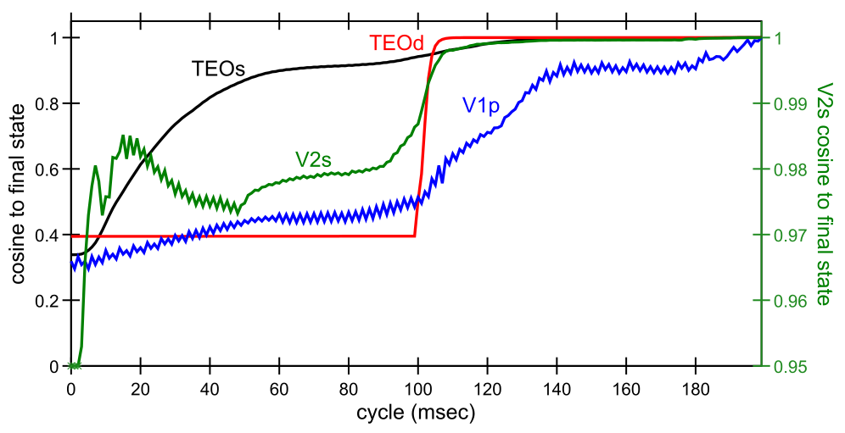
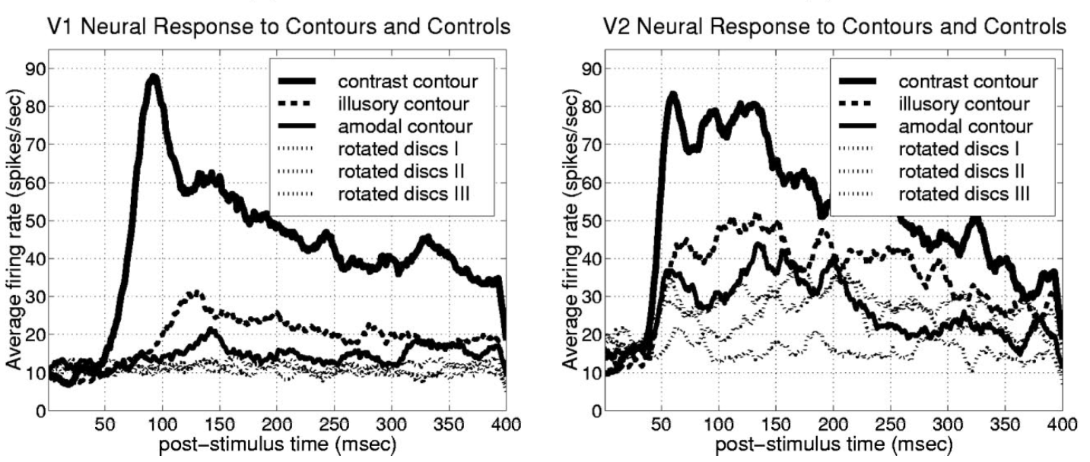
Top-Down Vision
Model filling in partial obj: TEO -> V2 -> V1p
High-level top-down key for perception!
^ Super et al., 2001: figure region enhanced via later top-down inputs (note: 100 msec!)
Lee et al.: Various forms of top-down activation in V1,V2 ->

Slide 34
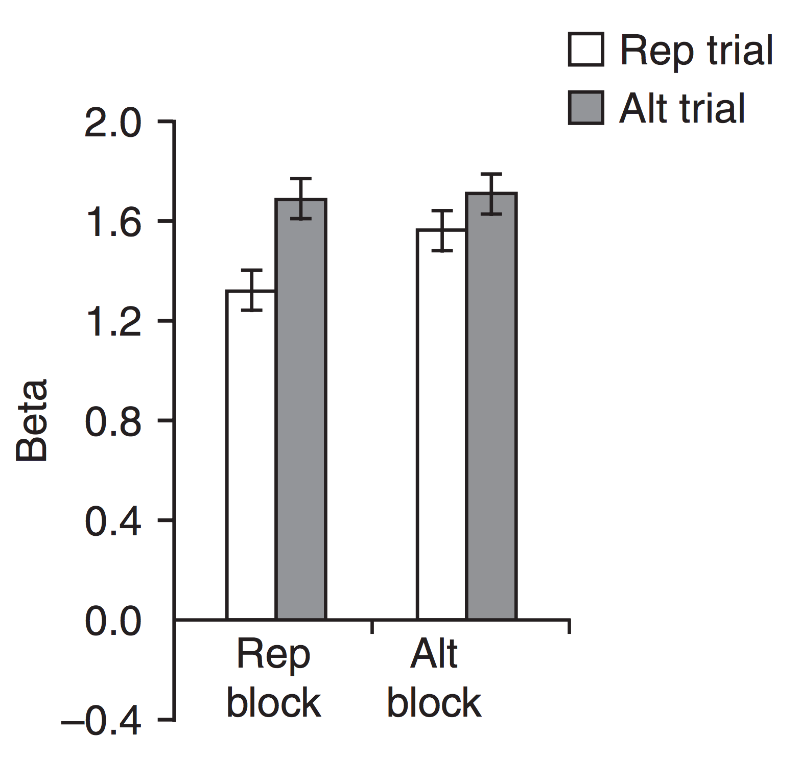
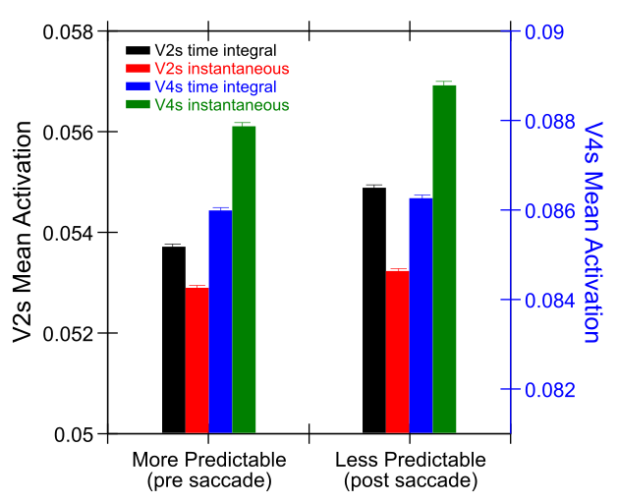
Explicit Error Coding?
Friston et al: superficial neurons explicitly code prediction error.
Summerfield et al. (2008): Repetition suppressed more when expected (Rep block) vs not (Alt block)
Model V2s: same effect via churn from prediction to actual outcome

Slide 35
Deep Predictive Learning Summary
Neocortex is massively bidirectionally interconnected: top-down from high-level abstract areas is key
Catch-22 in learning high-level abstractions when lower levels are not yet developed!?
Learn Where first
Partition residual error into What, What*Where
Self-organized invariant object representations in TEO: foundation for language, semantics, etc..
Accounts for predictive remapping (top-down), other top-down effects, & greater activation for unpredicted

Slide 36
Current / Future Directions
Scale up (3D objects, larger spatial maps..)
CIP specialized for 3D shape – What*Where in 3D?
Multiple objects and attention; physics of support, collision, occlusion… (Spelke et al)
Multimodal: vision + audition joint prediction, speech forward model, word learning..

Slide 37
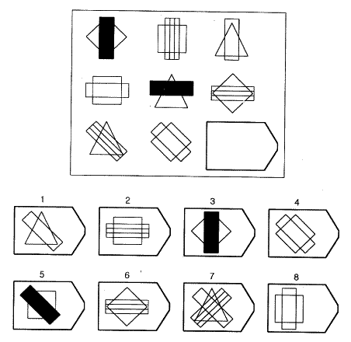
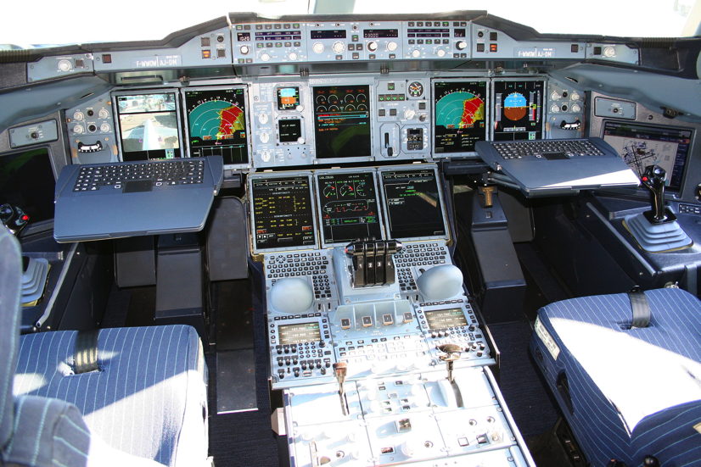
Cognitively: What is Vision For?
Vision is active, goal-driven, requires iterative, flexible parsing of complex visual scenes
Raven’s progressive matricies: test of general intelligence – depends on dynamic vision

Slide 38
Is the Pulvinar the Silver Screen of the Cartesian Theater??
We have a compelling feeling that our conscious selves are watching a movie – pulvinar is kind of a movie screen where all of our predictions are projected, at V1 resolution.. hmm..
Global workspace? Brain synchronizer?

Slide 39
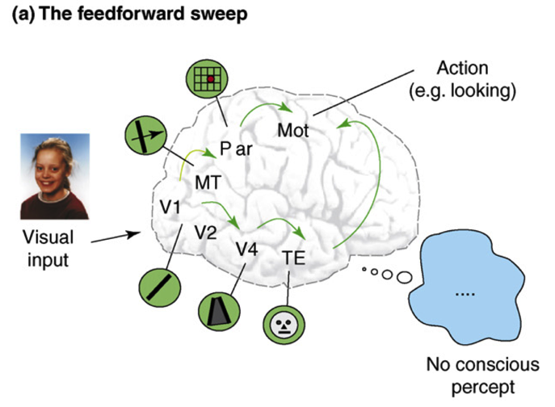
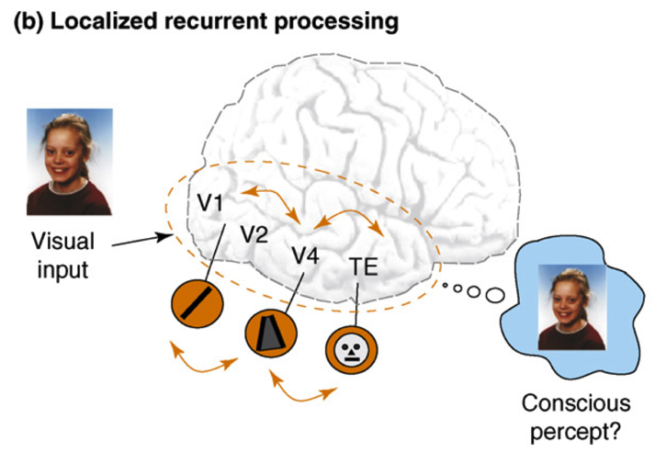
Recurrent Processing -> Consciousness (Lamme, 2006)
Consciousness is Unitary
Recurrence coordinates all areas on one thing (emerges via popular vote)
Consciousness is Functional
Helps organize, prioritize behavior – “focusing” key for difficult problems
Consciousness Flows
Temporal dynamics and information processing (multi-step cognition)

Slide 40
Two Functions of Deep/Thal Circuit
Attentional dynamics
Deep layers particularly important for top-down
Multiplicative, normalization dynamics
Predictive learning
Context from t-1 to predict at time t (SRN)
Time updates every 100 msec (10 Hz, alpha)
Thalamic relay cells (TRC) are substrate for local auto-encoder learning

Slide 41
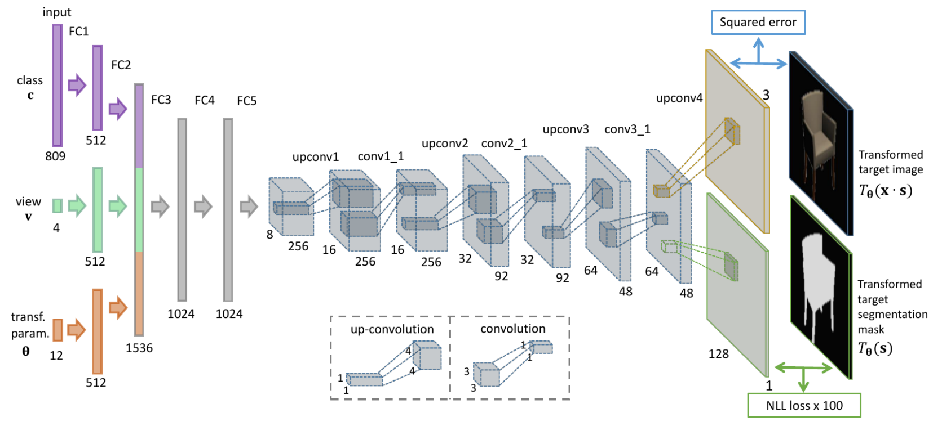
Generative Models
Dosovitskiy, A., Springenberg, J. T., Tatarchenko, M., & Brox, T. (2017)
Helmholtz (1867): Recognition by synthesis
Early brain theories: Carpenter and Grossberg, 1987; Mumford, 1992; Kawato et al., 1993; Ullman, 1995; Dayan et al., 1995; Rao & Ballard, 1999
Bayesian models: Lee & Mumford, 2003; Friston, 2005; Yuille & Kersten, 2006; Friston, 2008, 2010; Lee, 2015
If you could learn high-level, systematic generative model, you could predict…

Slide 42
Catch 22

Slide 43
How can you learn high-level abstraction like “cat” without first learning about fur, paws, texture, color, shapes, edges...?

Slide 44
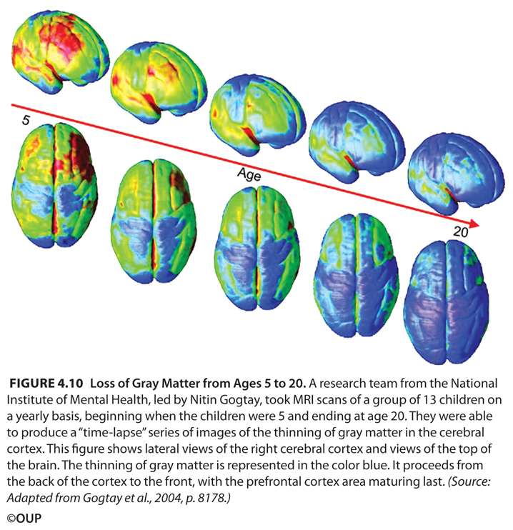
Bottom-up Development
Short-circuit the catch-22:
Progressively learn deeper layers:
each layer learns to encode / predict the one below it

Slide 45
Bottom-up Development
Short-circuit the catch-22:
Progressively learn deeper layers:
each layer learns to encode / predict the one below it

Slide 46
Need High-Level Abstractions NOW
First layers learn low-level features, replicated across visual space
These are bad at predicting regular motion of stable object features: need invariant object and motion trajectory representations
(it is the same object over time! it is moving in the same way over time – need the same representations!)
(and residual errors do not provide meaningful basis for learning higher-level abstractions)

Slide 47
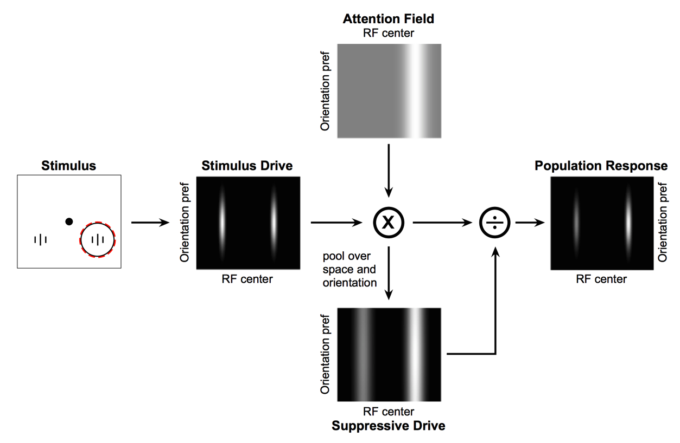
Deep Attentional Dynamics (Reynolds & Heeger, 2009; Grossberg, 1999)
Top-down deep layer
Attentional drive
Inputs to Layer 4
Layer 6 gain control
(Olsen, Bortone et al)

Slide 48
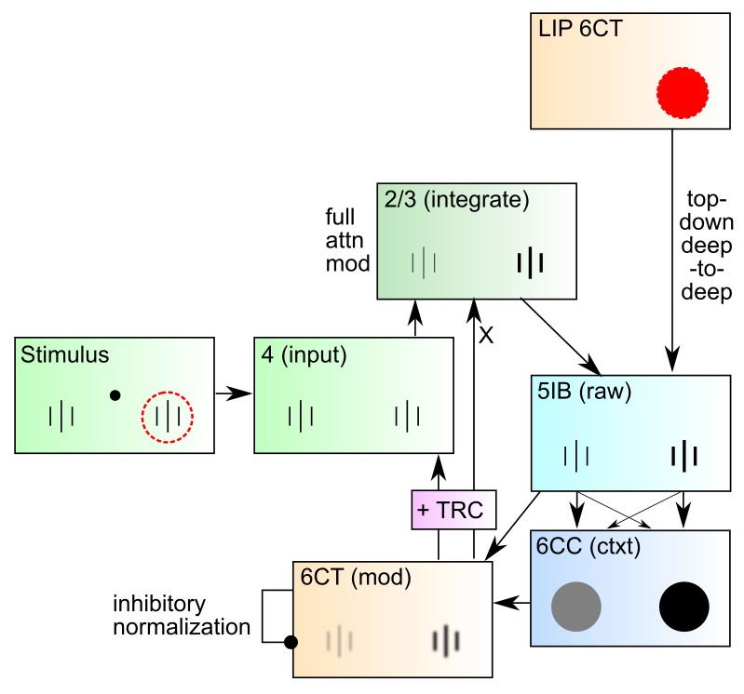
DeepLeabra Attentional Dynamics

Slide 49
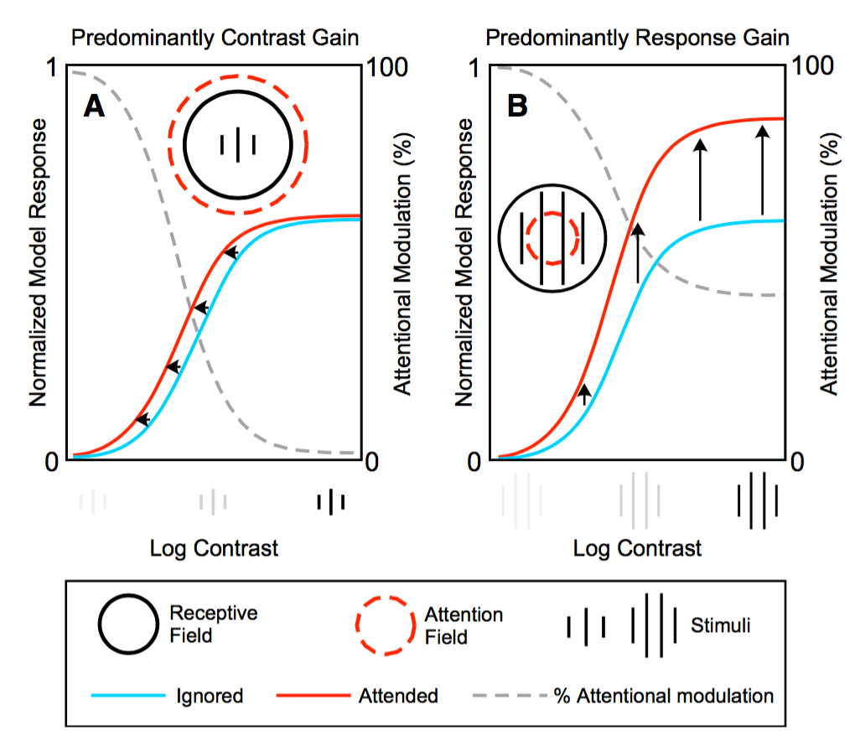
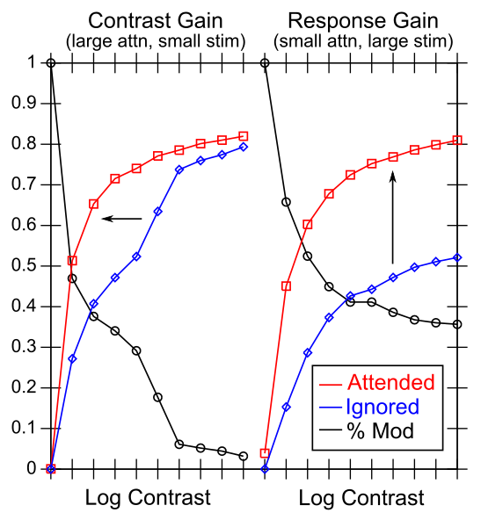
Attentional Dynamics Results

Slide 50
Attention and Alpha
Alpha power is stronger for unattended stimuli
Deep layers, oscillating at alpha frequency, modulate excitability of superficial layers
Attended: super excited, stronger gamma, less tied to deep modulation = lower alpha power
Unattended: super inhibited, remains entrained by deep alpha = stronger alpha power

Slide 51
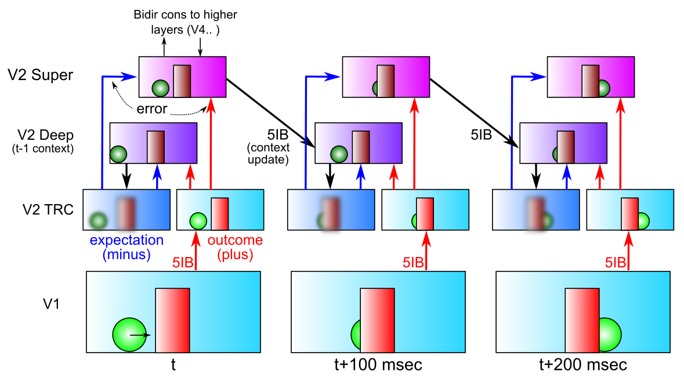
Key Prediction: Full Processing Requires 2 Alpha Cycles
First alpha cycle = bottom-up processing of new input without established prediction
Second cycle = deep-layer prediction (generative model of scene) contrasts with second wave of bottom-up processing, differences drive learning
Predictions: saccade duration = 2 alpha cycles; novel vs. familiar emerges in 2nd alpha cycle

Slide 52
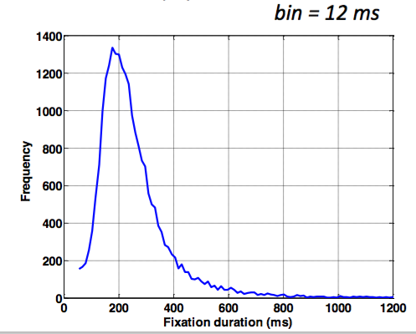

Data from David Sheinberg, Tim Curran’s labs Consistent with predictions from model
Super
Layers
(2 cyc,
nov vs
fam 2nd only)
Deep
Layers
(2nd cyc
only)
Left: super vs. deep local field potential in monkey IT cortex, showing 2 alpha-frequency waves in superficial layers, 1 in deep layers, with familiar vs. novel differences emerging in 2nd alpha cycle.
Right: fixation duration for humans in free viewing of complex scenes, with strong 200msec peak predicted by model (2 alpha cycles)

Slide 53
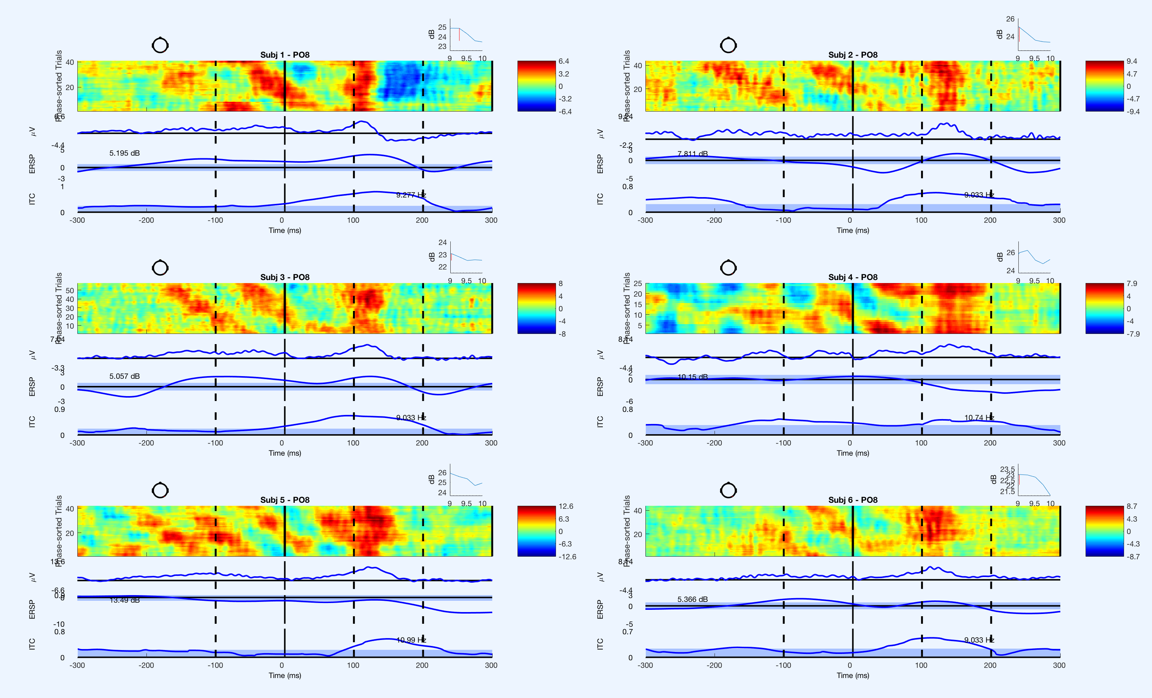
Saccade Resets Alpha (Zolfaghar, Devillez, Curran et al, in prep)
fixation onset
synchronized alpha

Slide 54
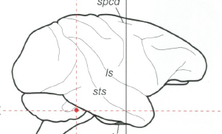
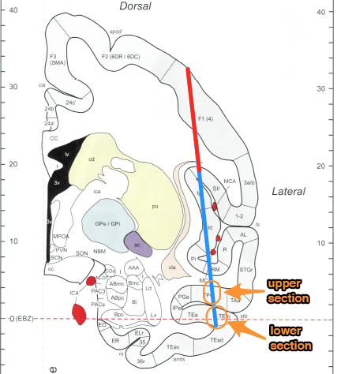
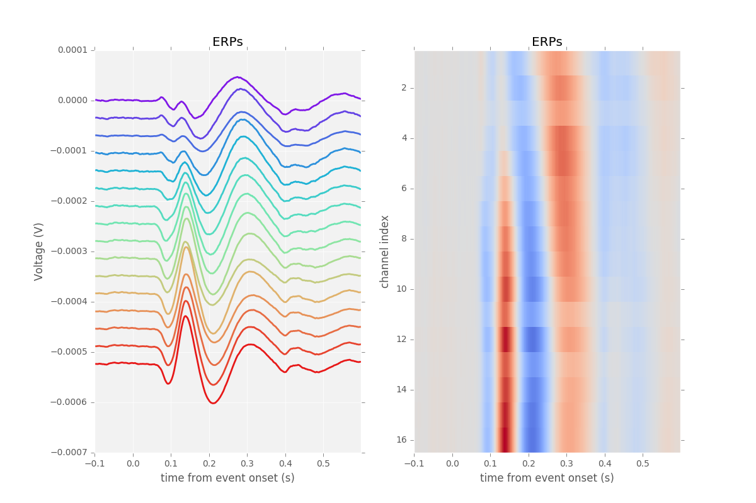



Simultaneous V4 and IT Recording (Guan & Sheinberg, in prep)
Spike waveforms

Slide 55
IT Encodes Familiarity First
Despite having slower onset, IT encodes familiarity before V4
} novel
} familiar
PSTH
significance
onset
offset

Slide 56

DeepLeabra
Deep neocortical layers drive multiplicative attentional modulation, through direct and thalamically mediated connections.
Alpha cycle (100msec) provides frame rate for updating of attentional mask, determined by 5ib bursting
EM-like dynamics where superficial network settles within fixed attentional mask, then attn mask is updated..
5ib also drives feedforward TRC prjn: plus phase clamp of TRC-based autoencoder (local learning signals)
6cc context provides SRN-like temporal context information for predictive learning

Slide 57

Deep / Pulvinar Connections

Slide 58
Bidirectional Constraint Satisfaction Word Superiority Effect: McClelland & Rumelhart, 1981

Slide 59

Superficial Attractor / Constraint Satisfaction Network
Computationally captured by Hopfield / (Deterministic) Boltzmann Machine models..
Except that cortical pyramidal neurons are only excitatory – need inhibitory interneurons

Slide 60


Leabra Biologically-based Cognitive Architecture
Same framework accounts for wide range of cognitive neuroscience phenomena: perception, attention, motor control and action selection, learning & memory, language, executive function – all built out of the same neurons.
http://ccnbook.colorado.edu

Slide 61
Two Parallel Networks: Thalamus & Cortex

Slide 62

Bidirectional Object Recognition (O’Reilly et al., 2013)
100-way invariant object recognition

